Slide 1

Hybrid Decentralization for Multi-Robot Orienteering with Mothership-Passenger Systems
Nathan L. Butler and Dr. Geoffrey A. Hollinger
Collaborative Robotics and Intelligent Systems (CoRIS) Institute
Oregon State University
NSF Award No.
2322055

Slide 2
Deploying MRS in hazardous environments
Mothership
Notes:
Motivation slide

Slide 3
Stochastic Multiagent Orienteering Problem
T
T
?
?
T
T
T
T
T
T
?
?
?
?
T
?
T
T
Mothership
Notes:
MOP/SMOP slide

Slide 4
Mothership
Mothership
Notes:
Hybrid topology slide(s) (if time)

Slide 5
How can we leverage a hybrid centralized-decentralized network available in Mothership-Passenger systems to solve complex orienteering problems?
Notes:
Gap

Slide 6
Hybrid Mission Planning
Observed local data
Received global data
Passenger i
Use up-to-date local observations
Respond quickly to local disturbances
Mothership
Use aggregated global information
Coordinate system-level actions
Locally-optimal plans
Globally-optimal plans
Notes:
Hybrid topology slide(s)

Slide 7
Hybrid Mission Planning
Passenger i
Stored Plans
Decentralized Solver
(Dec-MCTS [X])
Neighboring Robots
Plan Valuation & Selection
Candidate Plans
Notes:
Hybrid topology slide(s)

Slide 8






Hybrid Mission Planning
Mothership
Mothership
Centralized Solver
(Sim-BRVNS [X])
Centralized Solver
(Sim-BRVNS [X])
$$P_{i−2}^{}$$
$$P_{i−2}^{}$$
$$P_{i−1}^{}$$
$$P_{i−1}^{}$$
$$P_{i}^{}$$
$$P_{i}^{}$$
Notes:
Hybrid topology slide(s)

Slide 9

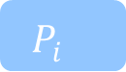
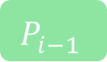
Hybrid Mission Planning
Mothership
Passenger i
Centralized Solver
(Sim-BRVNS [X])
Stored Plans
Decentralized Solver
(Dec-MCTS [X])
Neighboring Robots
Plan Valuation & Selection
$$P_{i−2}^{}$$
$$P_{i−1}^{}$$
$$P_{i}^{}$$
Candidate Plans
Notes:
Hybrid topology slide(s)

Slide 10
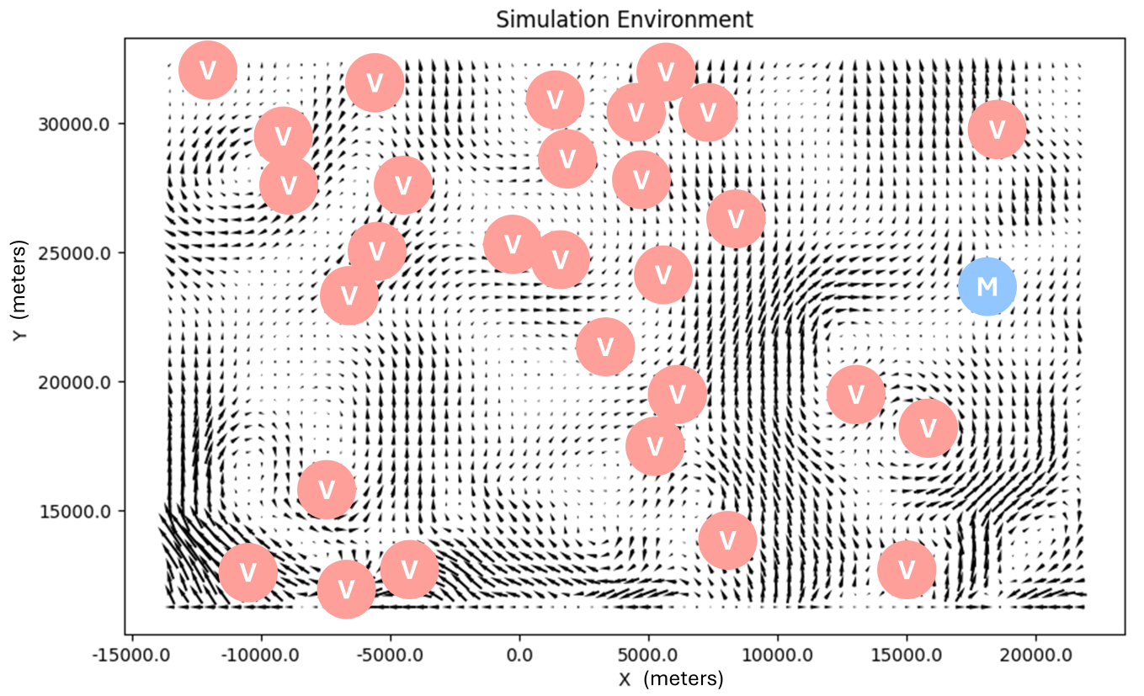
Evaluation in Simulated Ocean Domain
Notes:
Hybrid topology slide(s)

Slide 11

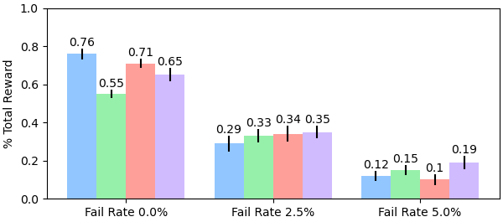
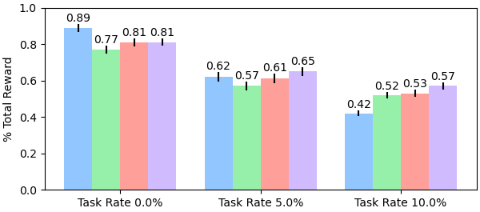
Experimental Results
3 Robots, 30 Tasks
Four algorithms:
Initial, centralized solution only (Sim-BRVNS)
Decentralized planning only (Dec-MCTS)
Initial + decentralized replanning (2-Stage)
Initial + hybrid replanning (2-Stage hybrid)
6 Robots, 20 Tasks
Initial (centralized) solution -> immediate coordination
Increased disturbances -> greater need for global coordination
Notes:
Hybrid topology slide(s)

Slide 12
Conclusions
Introduced Stochastic Multiagent Orienteering Problem
Explored leveraging mothership for hybrid decentralized problem solving
Evaluated scenarios where integrated mothership provides greatest benefits
Notes:
Hybrid topology slide(s)

Slide 13
Contact:
Nathan Butler: butlnath@oregonstate.edu
Dr. Geoffrey Hollinger: geoff.hollinger@oregonstate.edu
QR TO WEBSITE PAPER
NSF Award No.
2322055

Slide 14
References
TODO

